Slide 1
Revenue Insights in Hospitality Domain
Ridhima Gupta

Slide 2
Project Overview:
The Hospitality Revenue Insights Dashboard project aims to leverage Power BI, integrating Power Query and DAX functionalities along with Excel, to provide comprehensive revenue insights for the hospitality industry. This dashboard facilitates the analysis of revenue data to aid hospitality businesses in making informed decisions, optimizing strategies, and maximizing revenue potential.
Project Scope:
The project encompasses the collection, processing, and visualization of revenue-related data from various sources within the hospitality domain. It focuses on generating actionable insights and visual representations of revenue trends, performance metrics, and comparative analyses across different segments.

Slide 3
Problem Statement
Atliq grands owns multiple five-star hotels across India. They have been in the hospitality industry for the past 20 years. Due to strategic moves from other competitors and ineffective decision-making in management, atliq grands are losing its market share and revenue in the luxury/business hotels category. As a strategic move, the managing director of atliq grands wanted to incorporate “business and data intelligence” to regain their market share and revenue. However, they do not have an in-house data analytics team to provide them with these insights. Their revenue management team had decided to hire a 3rd party service provider to provide them with insights from their historical data.
Task: You are a data analyst who has been provided with sample data and a mock-up dashboard to work on the following task.
1.Create the metrics according to the metric list.
2.Create a dashboard according to the mock-up provided by stakeholders.
3.Create relevant insights that are not provided in the metric list/mock-up dashboard.

Slide 4
Steps of the Analysis Conducted
Requirement Understanding
Mockups and Solution Design
Data Collection and data modeling
Dashboarding and Insight Generation
Stakeholders Feedback
Special Feature: Stakeholder Involvement - Abhishek Anand, Revenue Manager at OYO Introduction This project is proud to have had direct involvement and guidance from Abhishek Anand, a distinguished figure in the hospitality industry serving as the Revenue Manager at OYO. As a key stakeholder, his expertise, insights, and validation have been integral in shaping and validating the outcomes of this real-time hospitality revenue insights project.

Slide 5
Analysis conducted
Data Collection:
Sources: Codebasics.io is a platform which puts out project challenges and provides the dataset for the same.
Data Transformation: Utilization of Power Query in Power BI to clean, transform, and shape raw data from different sources for analysis.
Data Analysis:
Calculation of Key Metrics: Implementation of DAX measures to compute key metrics like
1. REVPAR( Revenue per available room ) = Total revenue / Total rooms available to sell
2. ADR(Average Daily Rate) = Total rooms revenue / total rooms sold
3. OCUUPANCY % = Total rooms occupied / total rooms available
4. SRN: Sellable room nights
5. DSRN: daily sellable room nights
6. REALIZATION %= URN( Utilized Room Nights) / BRN(Booked Room Nights)
URN: rooms in which customer ends up staying.
BRN: contains URN, cancellations and no shows.

Slide 6
Segmented Analysis: Grouping data by parameters such as location, room type, booking channels, or customer demographics for detailed revenue segmentation.
Dashboard Creation:
Power BI Visualization: Leveraging Power BI's visualization capabilities to create interactive dashboards and reports.
-> Creating Key Performance Indicators of all the level one key metrics.
Creating various charts like line, donut and clustered charts.
Creating tooltips for the KPIs.
Integration with Excel: Utilizing Excel for additional data analysis, manipulation, and preprocessing to enhance the depth of insights.

Slide 7
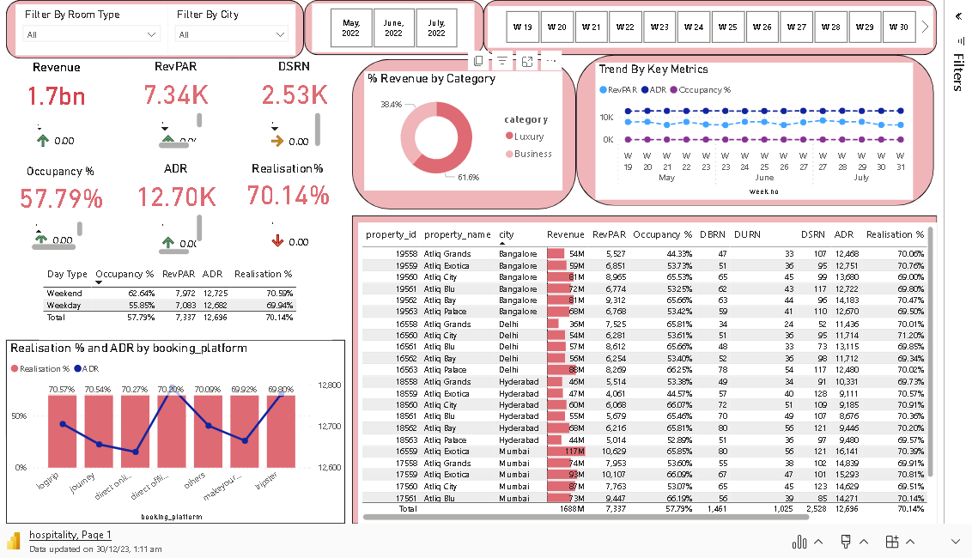

Slide 8
Outcomes and Insights
The analysis yielded several critical insights and outcomes:
Trend Identification: Visualization of revenue trends over time, highlighting seasonal patterns, peak periods, and areas of fluctuation.
Segment Analysis: Understanding revenue performance across different segments, identifying high-performing segments, and areas with potential for improvement.
ADR and RevPAR Analysis: Calculation and comparison of ADR and RevPAR metrics, enabling pricing strategies and room optimization decisions.
Realization Percentage Evaluation: Assessment of revenue realization against maximum potential, pinpointing areas for revenue optimization and efficiency improvement.
Actual Revenue Trends: Graphical representation of actual revenue generated over time, showcasing growth, declines, or seasonal variations.
Revenue Forecasting: Utilize historical data to forecast future revenue trends, aiding in proactive decision-making.

Slide 9
Conclusion
The Hospitality Revenue Insights Dashboard created using Power BI, Power Query, DAX, and Excel empowers hospitality businesses with actionable insights derived from comprehensive revenue analysis. It assists in strategic decision-making, enabling businesses to optimize revenue streams, enhance operational efficiency, and improve overall profitability in the dynamic hospitality landscape.

